Slide 1

TARGET FOLDER
SRNTGT100
[Severomorsk Ammunition Factory, SRN]
SECRET - DCS WORLD
REL TO COALITION
SECRET - DCS WORLD
REL TO COALITION

Slide 2

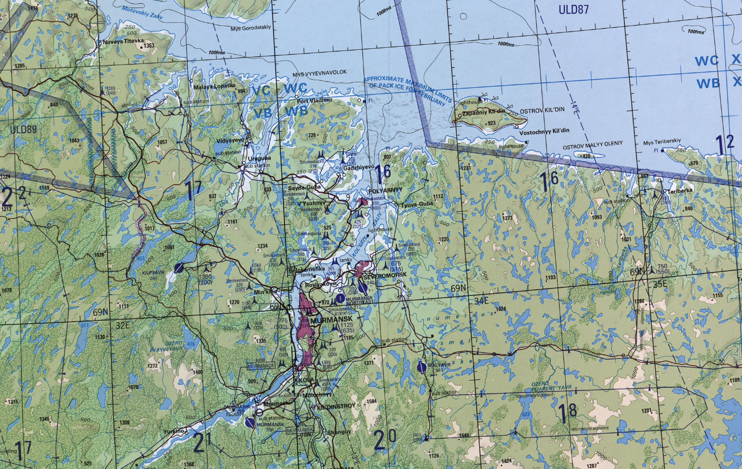
Severomorsk Ammunition Factory, SRN
OPAC CLASSIFIED REL TO CJTF-23
JOINT OPERATIONS GRAPHIC [X]
MAP
OVERVIEW
BE: SRNTGT100 CATCODE: 9
MIDB GEO: N 69 03.428 E 033 22.990
ICOD: 2011-JUL-06 DOI:2011-JUL-04
DECL ON: 2061-JUL-06
N
Severomorsk Ammunition Factory SRNTGT100
.

Slide 3
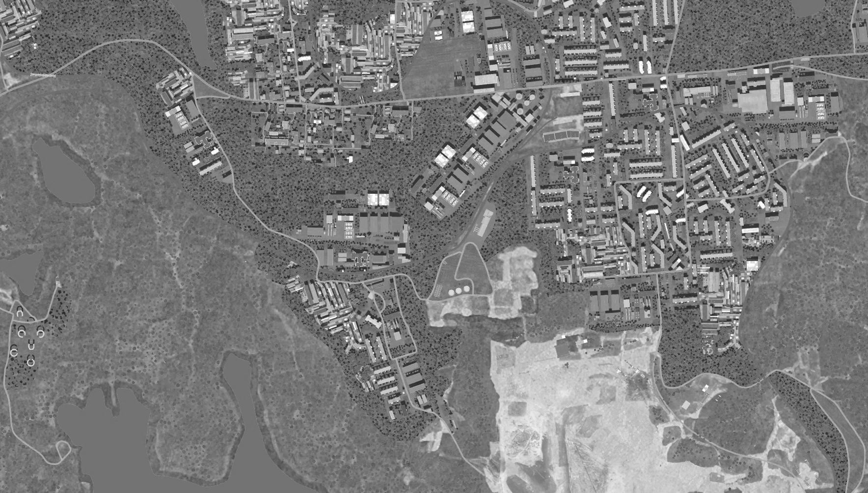
Severomorsk Ammunition Factory, SRN
OPAC CLASSIFIED REL TO CJTF-23
FACILITY OUTLINE GRAPHIC 1/1
MAP
OVERVIEW
BE: SRNTGT100 CATCODE: 9
MIDB GEO: N 69 03.428 E 033 22.990
ICOD: 2011-JUL-06 DOI:2011-JUL-04
DECL ON: 2061-JUL-06
N
Severomorsk Ammunition Factory SRNTGT100

Slide 4
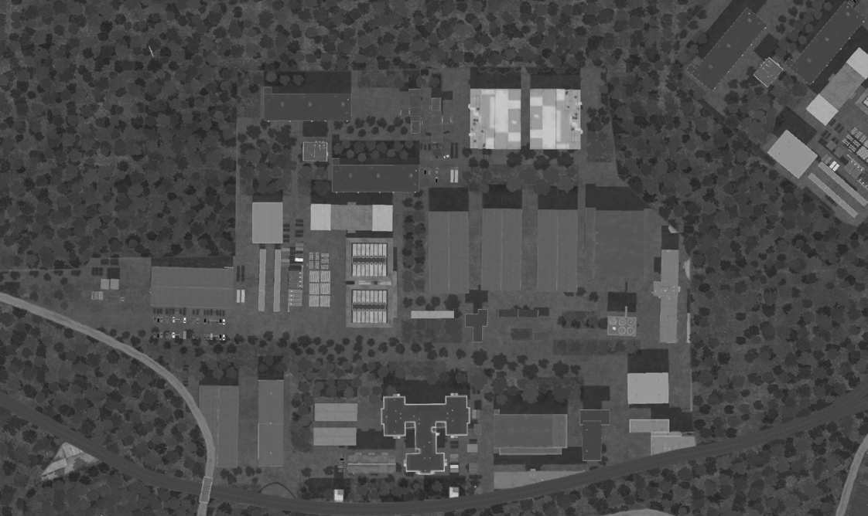
Severomorsk Ammunition Factory, SRN
OPAC CLASSIFIED REL TO CJTF-23
DESIRED POINT OF IMPACT GRAPHIC 1/1
MAP
OVERVIEW
BE: SRNTGT100 CATCODE: 9
MIDB GEO: N 69 03.428 E 033 22.990
ICOD: 2011-JUL-06 DOI:2011-JUL-04
DECL ON: 2061-JUL-06
DPI: B1
ROCKET PRODUCTION
N 69 03.464 E 033 22.989
DPI MSL: 152 FT
N
DPI: G
POWER DISTRIB FACILITY ON GRN
N 69 03.462 E 033 22.847
DPI MSL: 149 FT
DPI: C
ARTILLERY SHELL PRODUCTION
N 69 03.433 E 033 22.866
DPI MSL: 165 FT
DPI: B2
ROCKET PRODUCTION
N 69 03.436 E 033 22.779
DPI MSL: 162 FT
DPI: A
BOMB PRODUCTION
N 69 03.436 E 033 22.779
DPI MSL: 162 FT
DPI: D1
CHEMICAL STORAGE ON GND
N 69 03.412 E 033 22.795
DPI MSL: 172 FT
DPI: D1
CHEMICAL STORAGE ON GND
N 69 03.405 E 033 22.790
DPI MSL: 174 FT
DPI: E1
REVETTED CHEMICAL STORAGE
N 69 03.414 E 033 22.883
DPI MSL: 172 FT
DPI: E2
REVETTED CHEMICAL STORAGE
N 69 03.396 E 033 22.871
DPI MSL: 177 FT
DPI: F
CHEMICAL STORAGE IN SILO
N 69 03.367 E 033 32.145
DPI MSL: 158 FT

Slide 5
Severomorsk Ammunition Factory, SRN
OPAC CLASSIFIED REL TO CJTF-23
WEAPONEERING OPTIONS 1/1
MAP
OVERVIEW
BE: SRNTGT100 CATCODE: 9
MIDB GEO: N 69 03.428 E 033 22.990
ICOD: 2011-JUL-06 DOI:2011-JUL-04
DECL ON: 2061-JUL-06
DPI | DESCRIPTION | TLE | WARHEAD | GUIDANCE | DESIRED EFFECT | IMPACT ANGLE | FUZING
A | BOMB PRODUCTION PLANT | CAT 2 | 1000 lbs | METRIC | BLAST, FRAGMENTATION | 60-90 | 25ms
B1 | ROCKET PRODUCTION PLANT 1 | CAT 2 | 1000 lbs | DEMIMETRIC | BLAST, FRAGMENTATION | 60-90 | 25ms
B2 | ROCKET PRODUCTION PLANT 2 | CAT 2 | 1000 lbs | DEMIMETRIC | BLAST, FRAGMENTATION | 60-90 | 25ms
C | ARTILLERY SHELL PRODUCTION PLANT | CAT 2 | 1000 lbs | METRIC | BLAST, FRAGMENTATION | 60-90 | 25ms
D1 | CHEMICAL STORAGE | CAT 2 | 1000 lbs | DEMIMETRIC | BLAST, FRAGMENTATION | 60-90 | 0ms
D2 | CHEMICAL STORAGE | CAT 2 | 1000 lbs | DEMIMETRIC | BLAST, FRAGMENTATION | 60-90 | 0ms
E1 | REVETTED CHEMICAL STORAGE | CAT 2 | 1000 lbs | METRIC | BLAST, FRAGMENTATION | 60-90 | 10ms
E2 | REVETTED CHEMICAL STORAGE | CAT 2 | 1000 lbs | METRIC | BLAST, FRAGMENTATION | 60-90 | 10ms
F | SILOD REVETTED CHEMICAL STORAGE | CAT 2 | 1000 lbs | DEMIMETRIC | BLAST, FRAGMENTATION | 80-90 | 0ms
G | POWER DISTRIBUTION FACILITY | CAT 2 | 1000 lbs | DEMIMETRIC | BLAST, FRAGMENTATION | 60-90 | 25ms

Slide 6
Severomorsk Ammunition Factory, SRN
OPAC CLASSIFIED REL TO CJTF-23
COLLATERAL DAMAGE ESTIMATION GRAPHIC 1/1
MAP
OVERVIEW
BE: SRNTGT100 CATCODE: 9
MIDB GEO: N 69 03.428 E 033 22.990
ICOD: 2011-JUL-06 DOI:2011-JUL-04
DECL ON: 2061-JUL-06
N
400 FT
DPI E
NCC: Civilian Offices
300FT S FROM DPI-E
CDE5

Slide 7
Severomorsk Ammunition Factory, SRN
OPAC CLASSIFIED REL TO CJTF-23
COLLATERAL DAMAGES ESTIMATION 1/1
MAP
OVERVIEW
BE: SRNTGT100 CATCODE: 9
MIDB GEO: N 69 03.428 E 033 22.990
ICOD: 2011-JUL-06 DOI:2011-JUL-04
DECL ON: 2061-JUL-06
COLLATERAL DAMAGES WITHIN A 500M RADIUS
DESCRIPTION |  | CATCODE | MIDB GEOS | LOCATION | REMARKS
Civilian Offices |  | 14 |  | 300ft S DPI E | Potential Civilian Casualties
NO STRIKE ENTITIES WITHIN A 500M RADIUS
NSE ID | DESCRIPTION | CATCODE | MIDB GEOS | LOCATION | REMARKS

Slide 8
Severomorsk Ammunition Factory, SRN
OPAC CLASSIFIED REL TO CJTF-23
MAP
OVERVIEW
BE: SRNTGT100 CATCODE: 9
MIDB GEO: N 69 03.428 E 033 22.990
ICOD: 2011-JUL-06 DOI:2011-JUL-04
DECL ON: 2061-JUL-06
POST-STRIKE
PRE-STRIKE
N
TARGET OBJECTIVE
DAMAGE/CHANGE ASSESSMENT
DPI:[XXXXXX]
BDA REMARK: [CLASSIFICATION] [DISSEMINATION] Assessment: Physical Damage/change, Collateral Damage, Functional Damage/change, Munitions Effectiveness, Reattack Recommendation, Additional/Collateral Effects

Slide 9

ACRONYMS
ACRONYM | MEANING | DEFINITION
BE | Basic Encyclopedia Number | Alpha/numeric code unique to an installation for incorporation within various national and tactical systems.
CATCODE | Category Code | The data Element that classifies the function and purpose of an installation or a facility.
MIDB | Modernized Integrated Database | A database comprised of information on facilities of military significance, military forces, and related equipment.
ICOD | Intelligence Cut Off Date | The date of the latest intelligence data inputted to a feature.
DOI | Date of Image | Date on which a geospatial or intelligence-related image was captured.
CE | Critical Element | An element of an entity or object that enables it to perform its primary function.
PV CHAR | Physical Vulnerability Characteristic | Standardized alphanumeric code describing the physical and structural properties of a target.
DPI | Joint Desired Point of Impact | A unique, alphanumeric coded aimpoint identified by a three dimensional mensurated point. It represents a weapon or capability desired point of impact or penetration.
CE90 | Circular Error at 90% | 90 percent confidence level in the horizontal plane.
LE90 | Linear Error at 90% | 90 percent confidence level in the vertical dimension
MSL | Mean Sea Level | Elevation above Earth reference geoid.
AGL | Above Ground Level | Elevation above ground surface.
NCC | Nearest Collateral Concern | Closest non-targeted structure, area, or entity near a planned point of impact that may be at risk of unintended damage during a military strike.
CER | Collateral effects radius | Radius within which collateral damage might happen based on the weapon's characteristics, the target environment, and other operational factors.
CDE | Collateral damage estimate | Systematic process used in military targeting to evaluate the potential for unintended damage or harm to non-combatant entities, structures, or personnel as a result of a planned strike.
NSE | No Strike Element | Specific entities, locations, or objects that are protected from intentional targeting under the Law of Armed Conflict (LOAC) or by operational policy.

